Slide 1
UTLP PROJECTLP Project
TEAM NAME : csk
Team NUMBER: 1
Project title : product price display
Team head: kailasa eswaran i (it) – rit
VICE CAPTAIN: manikandan s (EEE) - RIT
Team members : durairaj m (IT) - RIT
mukeshkanna b (eee) – RIT
rahulkanna r (EEE) - RIT
Nivethitha m(ece) -rec
Saradha priya dharshini rc (ece)-rec

Slide 2
ABSTRACT
This Project enables the user to choose their favourite product in a easy and efficient way.
The User will be provided with a set of statements asking him/her to touch the color corresponding to their choice.
Once the user has placed their order, the character LCD will display the name of product that has been selected.

Slide 3
ULK INTERFACES INVOLVED
Graphical LCD
Character LCD
7 Segment Display

Slide 4
ULK GRAPHICAL LCD INTERFACING
This interface is used to display a set of 4 different colors.
Each color represents a particular product
ORANGE -Backcase
BLUE -Flip cover
GREEN -Pendrive
BLACK -Temper glass
For every touch of the user the corresponding cost of each product will be displayed in 7 segment display

Slide 5
ULK CHARACTER LCD INTERFACING
The character LCD intimates the product that has been selected by the user.
If it displays the message “BACK CASE”, it means that the user should touch the ORANGE colour in order to buy back case.

Slide 6
ULK 7 SEGMENT DISPLAY INTERFACING
The 7 segment display is used to display the cost of product.
This means that, every time an user choose one product the respective cost of the product will be displayed in the 7 segment LCD.
Thus the cost of the product can be known easily.

Slide 7
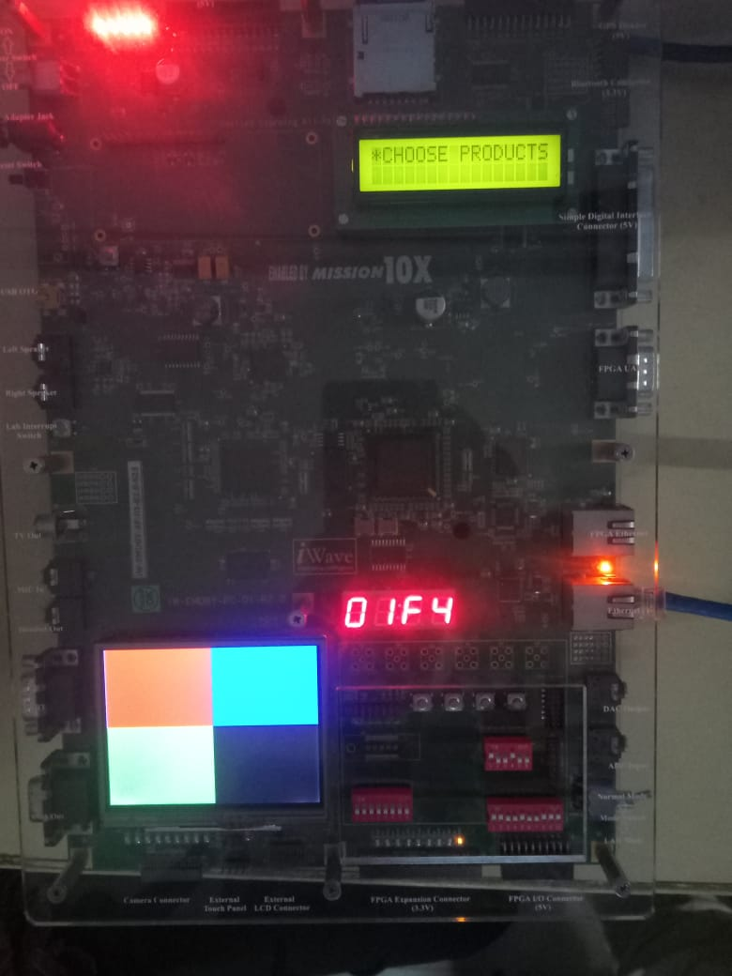
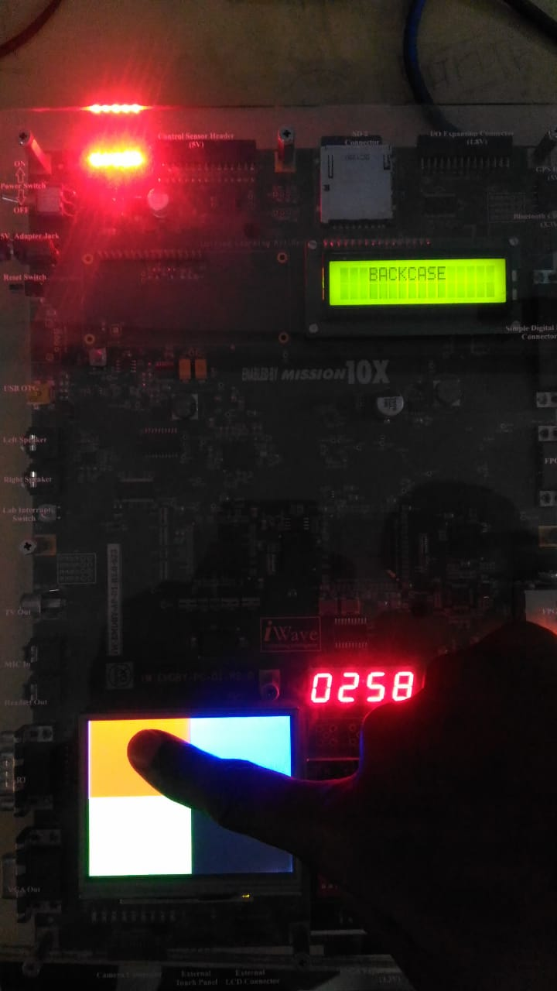
OUTPUT

Slide 8
ADVANTAGES
It makes the process of placing orders on each product easier and time efficient.
Portable and easy to implement.
The cost of each product can be easily known.

Slide 9
FUTURE ENHANCEMENT
This project can be implemented in shopping malls in order to display cost of each and every product.
Further it can be enhanced for bill generation also.

Slide 10
Thankyou!

